Slide 1
PCOS Prediction using ML
Kiruthika J - 78
Likhitha Verma A- 84
Madhumitha S- 86

Slide 2
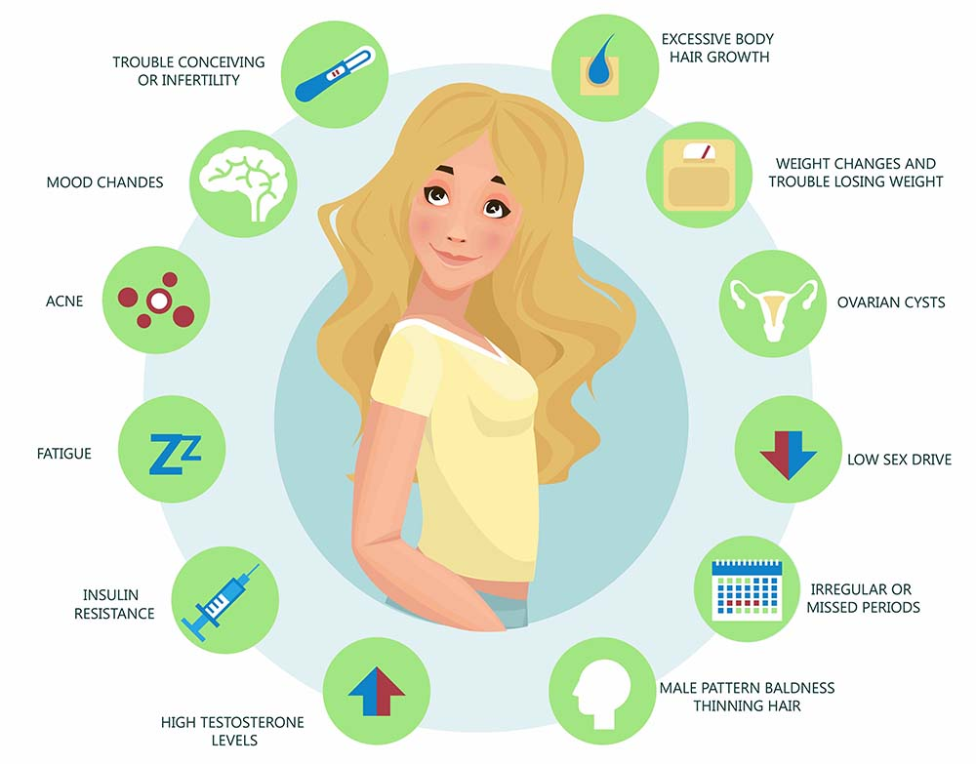
PCOS

Slide 3

Why this topic?
PCOS - an increasing issue of concern among today’s women
Sedentary lifestyle and Food habits
Lack of awareness
Physical inactivity
Unhealthy junkies
Increasing stress levels
Existing methodologies and treatments are insufficient for early-stage detection and prediction

Slide 4
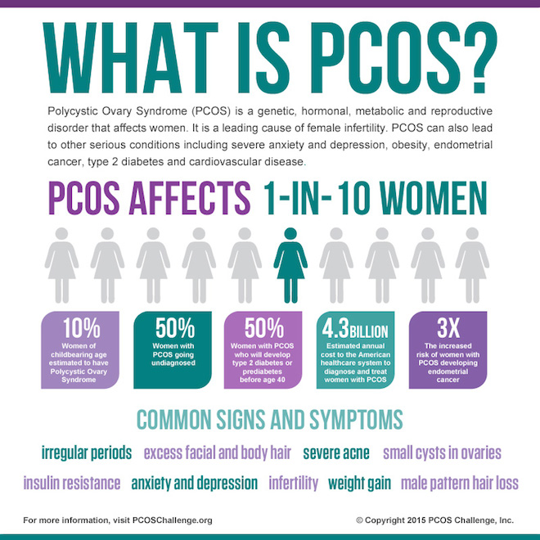
How tech can be used to predict it at the Earliest?
Using ML techniques the probability of PCOS risk can be predicted
PARAMETERS that influence:
BMI
Weight
Height
Blood group
Age
Comorbidities
Stress level

Slide 5

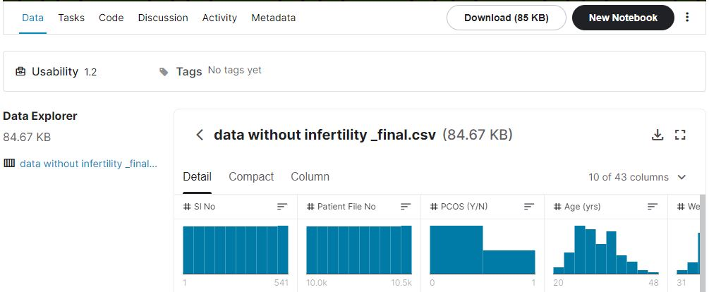
Dataset Source

Slide 6

Machine Learning technique proposed

Slide 7
Architecture :
Dataset
Load Data
Pre-processing
Feature-Extraction
(chi² test)
Predictive model
Training data
Expected
Label
Model training
(RF Classification)
Split Dataset
(80-20)
Testing data

Slide 8
Feature Selection - Chi Square Test
A chi-square (χ2) statistic is a test that measures how expectations compare to actual observed data (or model results).
The data used in calculating a chi-square statistic must be random, raw, mutually exclusive, drawn from independent variables, and drawn from a large enough sample.
There are two main kinds of chi-square tests: the test of independence, goodness-of-fitness test.

Slide 9
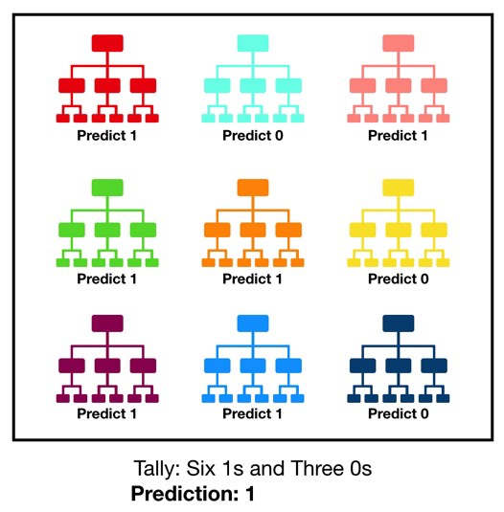
Random forest classifier
Random forest consists of a large number of individual decision trees that operate as an ensemble.
Each individual tree in the random forest spits out a class prediction and the class with the most votes becomes our model’s prediction.

Slide 10
Why Random Forest ?
Random forest is a simple but powerful one.
The low correlation between models is the key.
The reason for this wonderful effect is that the trees protect each other from their individual errors.
While some trees may be wrong, many other trees will be right, so as a group the trees are able to move in the correct direction.

Slide 11
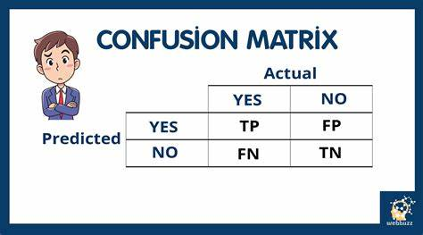
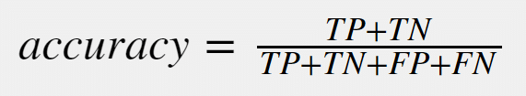
Accuracy and Prediction Results

Slide 12
THANK YOU

